Slide 1
CV32E40P v2 Project Concept
Olivier Monfort, Pascal Gouedo
Dolphin Design
June 28, 2021

Slide 2
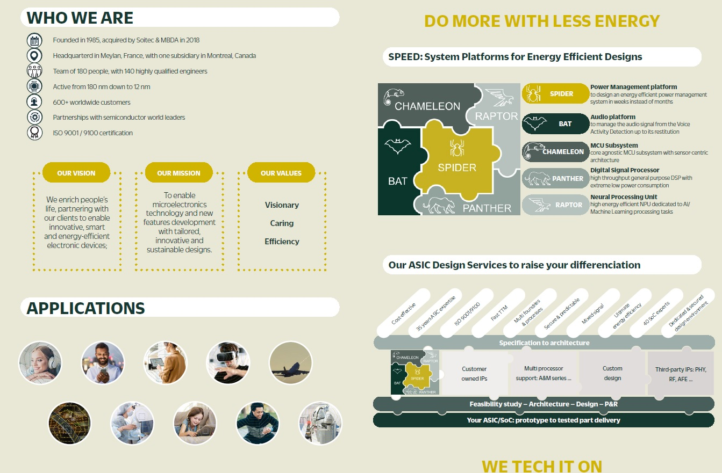
Dolphin Design

Slide 3
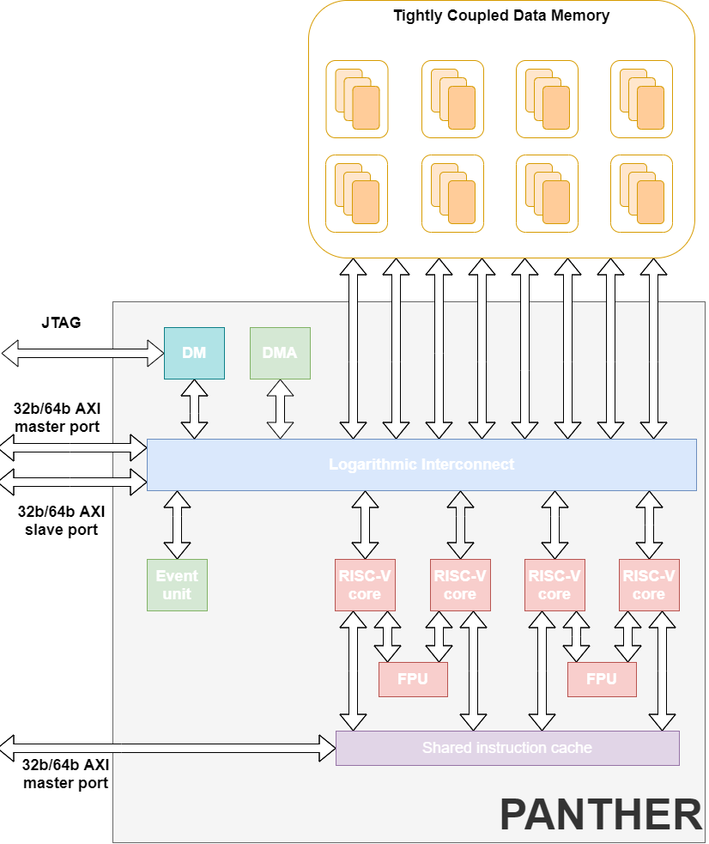
CV32E40P v2 use case for Dolphin Design
Target of CV32E40P v2 is integration in
PANTHER multicore cluster
Final PANTHER delivery packaging is
2022 Q2

Slide 4
Project Concept
High Level Summary of project
Verifying XPULP, RVF, and Zfinx ISA extensions that were disabled during CV32E40P v1 phase improving performances, power consumption and code size depending of application programs
Who would make use of OpenHW output
Companies needing more performances, less energy consumption or smaller code size for
Standard control applications
DSP-like computing applications
Explanation of why OpenHW should do this project
Finalize CV32E40 as originally intended in the CV32E40 Features and Parameters to propose a more powerful/optimized version of CV32E40

Slide 5
Project Requirements
Re-Encode in Custom extension and Verify PULP “basic” instructions which
Improve performances and power consumption
And even reduce code size depending of application programs
They are
Post-increment and register-register indexed load/store
Hardware Loops
General ALU extensions
Immediate Branch
Multiply and Accumulate
Re-Encode in Custom extension and Verify Bit Manipulation and SIMD PULP instructions which
Improve performances and power consumption on specific workloads

Slide 6
Project Requirements
Re-Encode in Custom extension and Verify PULP instructions used for Cores synchronization
PULP Event load
For Multicore cluster area reduction
Verify PULP Zfinx?
or Re-Design (if needed) and Verify Zfinx as described in zfinx-spec-20210511-0.41?
Make it optional with a parameter?
Floating Point Unit
Keep FPU instructions decoding inside the Core and dispatch to APU interface and Verify RISC-V standard F extension instructions (Zfinx and non-Zfinx) with coupled Core-FPnew?
or Merge ETH CV-X-IF and only Verify this interface?

Slide 7
Potential future design enhancements
Conversion of PULP Bit Manipulation & SIMD instruction to ratified RISC-V B and P extensions.
Add Zce extension for further code-size reduction (not required for Multicore cluster).
Add bus attributes and errors.

Slide 8
Project Concept
Initial Estimate of Timeline
Preliminary RTL release in 2021 Q4
Implementation of the test plan is assumed to be started in July/August 2021
Verification is expected to complete in 2022 Q1
Industry landscape: description of competing, alternative, or related efforts in the industry
ARM Cortex M4

Slide 9
Project Concept
OpenHW Members/Participants committed to participate
Dolphin Design - Design & Verification
Technical Project Leader(s)
At of Project Concept, led by Pascal Gouedo, Dolphin Design

Slide 10
Project Concept
Next steps/Investigation towards Project Launch
Verification to be assessed in detail
Google ISG
Imperas reference model
SW GCC toolchain support
Confirmation of Resources & Schedule
Additional information
OneSpin RISC-V and FPU apps as well as 360 DV-Verify licenses purchased by Dolphin Design for this Multicore cluster industrialization

Slide 11
CV32E40P v2
Final Project requirements
Davide Schiavone
OpenHW Group
Olivier Monfort, Pascal Gouedo, Yoann Pruvost
Dolphin Design
July 5, 2021

Slide 12
Final CV32E40P v2 features choice
Re-Encode in Custom extension all PULP “basic” instructions and Verify them
Post-increment and register-register indexed load/store
Hardware Loops
General ALU extensions
Immediate Branch
Multiply and Accumulate
Re-Encode in Custom extension all PULP instructions and Verify them
Bit Manipulation
16- and 8-bit SIMD
No addition of 4- and 2-bit SIMD version

Slide 13
Final CV32E40P v2 features choice
Re-Encode in Custom extension and Verify PULP instructions used for Cores synchronization
PULP Event load
For Multicore cluster area reduction
Verify PULP Zfinx
Floating Point Unit
Keep FPU instructions decoding inside the Core
Dispatch them using APU interface
⇨ With the listed features, E40P name can be kept as it complies with rules.

Slide 14
Status
Started to setup core-v-verif environment w/ Mike Thompson support
Started contacting Imperas
to get CV32E40P v1 Reference Model license to start running UVM environment
to add Custom PULP instructions into Reference Model
Continue to talk with Embecosm to add Custom PULP instructions into GCC SW toolchain

